Slide 1
Interviewers manual screenshot

Slide 2
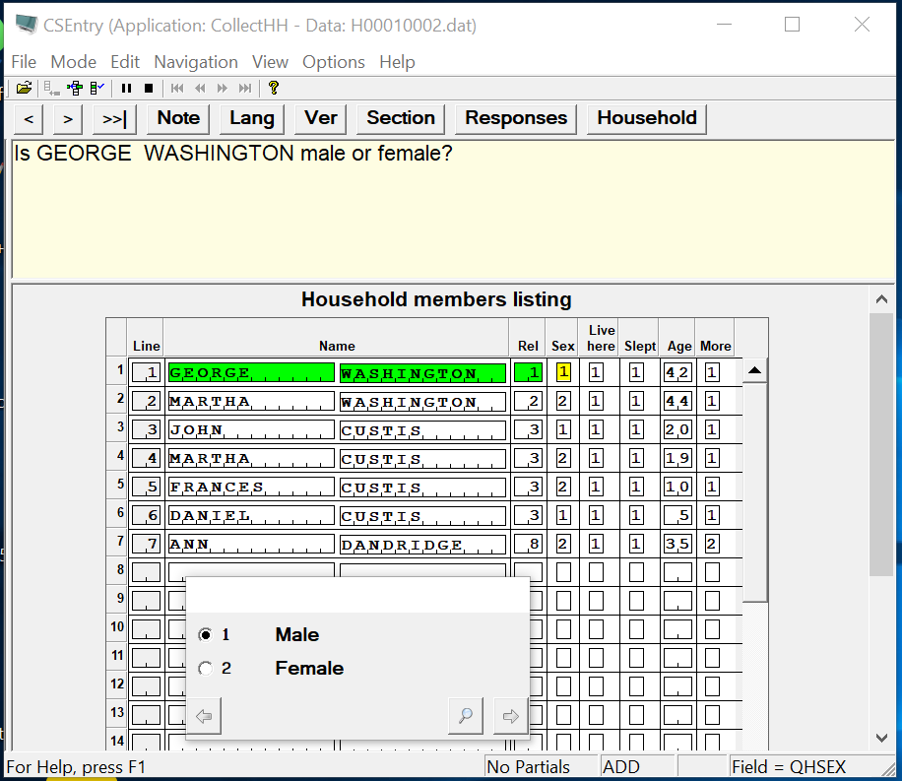
DHS CAPI FORM using CSPro
1. CSPro Data Entry options
2. CAPI defined Buttons
3. Question-display panel
4. Field’s definition panel
4a. Data entry fields
4b. Data capture controls
5. CSPro status bar information

Slide 3


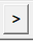
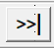
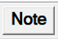
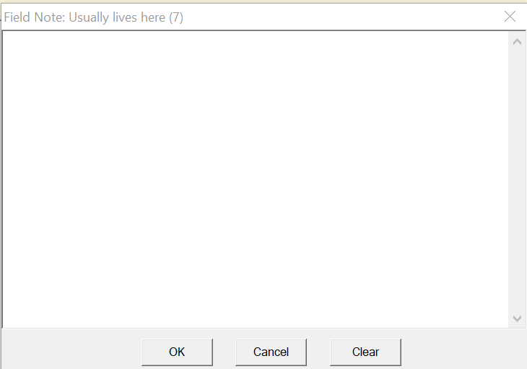
By pressing this button, the cursor moves one field back. The button is also known as the “Back button”.
By pressing this button, the cursor moves one field forward. The button is also known as the “Advance button”. It is important to note that CSPro doesn’t move forward unless some information is entered or is already present in the field where the cursor is placed
By pressing this button, the cursor moves to the end of the questionnaire or the last field where information has been already entered. This button is very useful when reviewing or modifying information in a questionnaire because after modifications it is necessary to go to the end of the questionnaire. This button has the same functionality as the F10 key in the tablet keyboard.
By pressing this button, CSPro displays a window where interviewers can take notes related to the question where the cursor is placed or any note that interviewers deem important at any time during the data collection process. The window displayed by CSPro looks like the figure below. After typing the note users (interviewers) press the OK button to go back to the field where the note was taken.

Slide 4
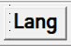
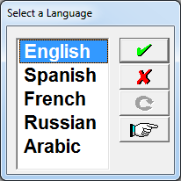

By pressing this button users can change the languages defined for the survey.
A window like the one on the right is displayed by CSPro after pressing this button.
Users will highlight the desired language and click on the green check button
to select the highlighted language.

Slide 5
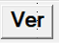
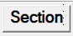
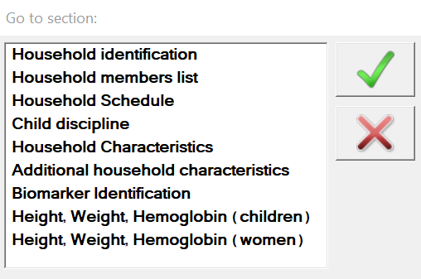
By pressing this button, a message with the last day date of the application (.apc) file will show. This help to know if the machine has the last updated programs.
By pressing this button, the system will display a list of all the sections of the main dictionary/questionnaire. This is a “Go to” button. Clicking on a section will take the cursor to the first field of the section, if data has been entered up to that section.

Slide 6
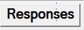
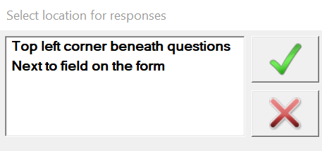
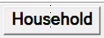
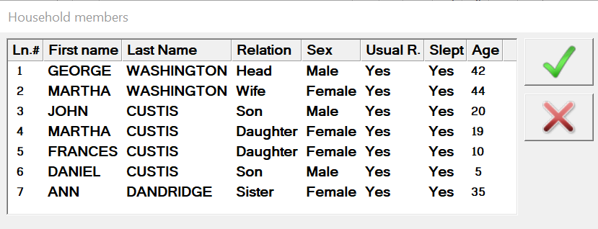

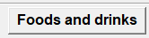


By pressing this button, the system will display the screen on the right. These two options allow to locate the response categories on “the top left corner beneath questions” or “next to the field on the form”.
By pressing this button, it will show the list of the household members with their relationship, sex, age and other variables.

Slide 7

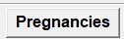
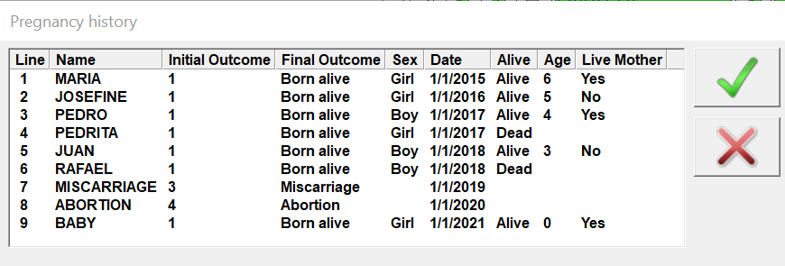
By pressing this button, the system will display the screen on the right. These two options allow to locate the response categories on “the top left corner beneath questions” or “next to the field on the form”.

Slide 8
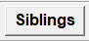
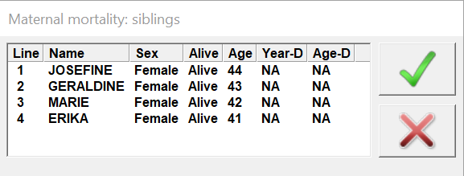
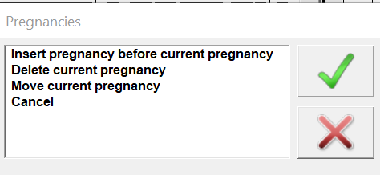
By pressing this button, the system will display the screen on the right. These two options allow to locate the response categories on “the top left corner beneath questions” or “next to the field on the form”.

Slide 9
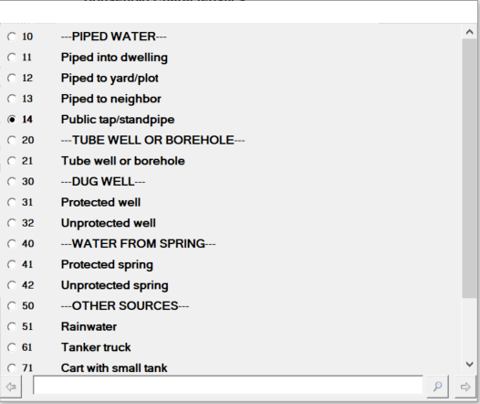
Codes
Radio
Buttons
Category label
Scrolling
Search box
Back
Advance

Slide 10
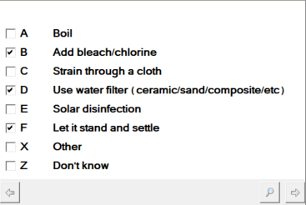
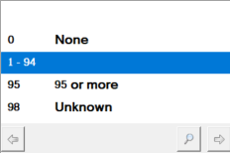
Multiple selection box
Single value
Ranges
Single value

Slide 11
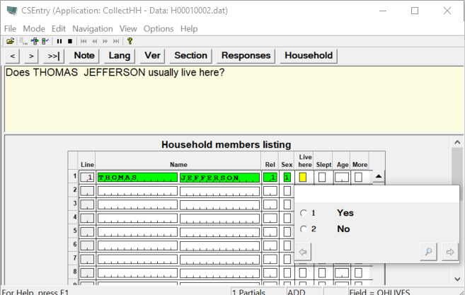

Slide 12
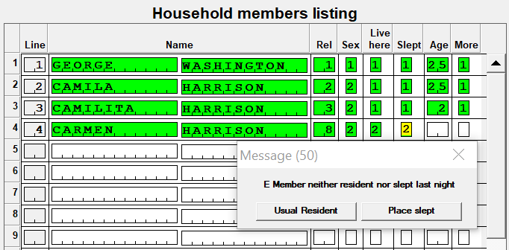
Error number
Error type
Error text
Return to buttons

Slide 13
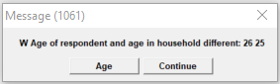
Error type
Continue button

Slide 14
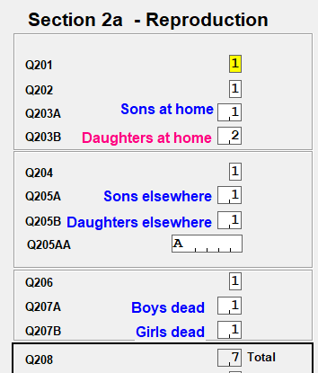
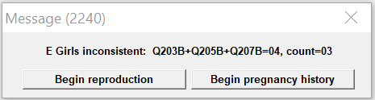
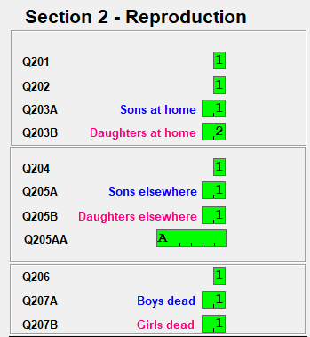
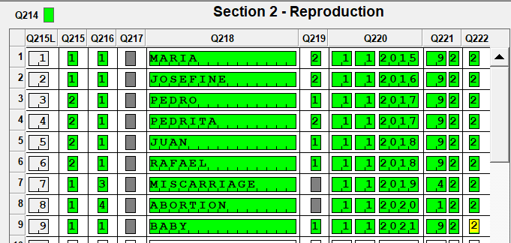
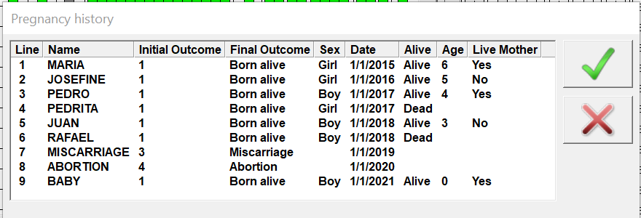
Error
type
Return buttons

Slide 15
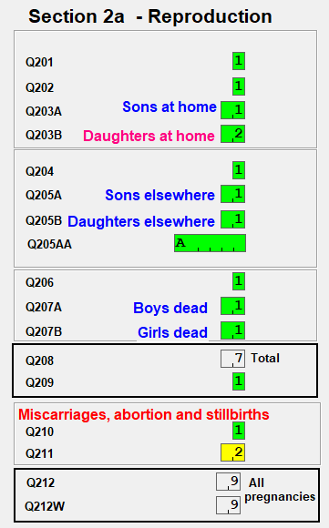
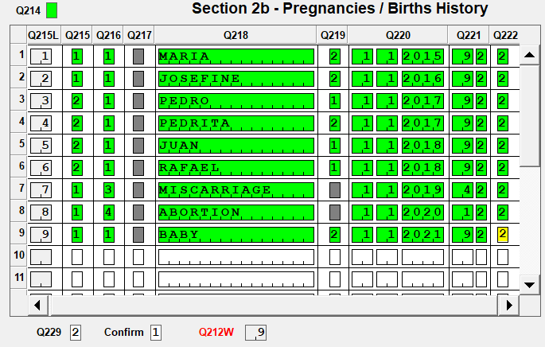
Go
to
Go
to

Slide 16
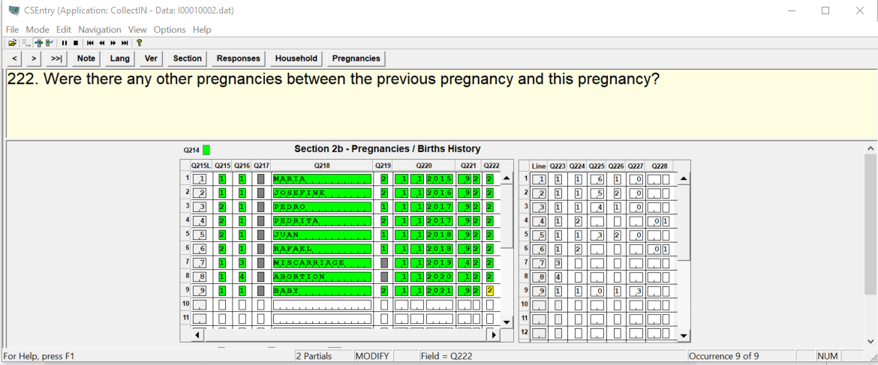

CSPro Status Bar

Slide 17


Slide 18
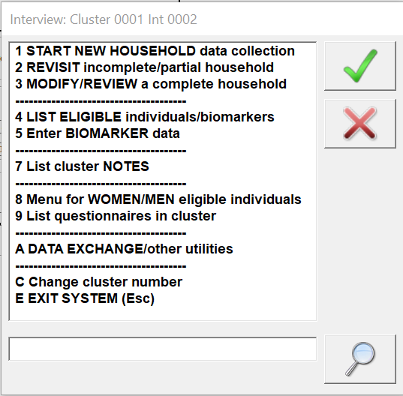
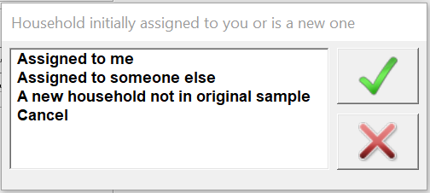
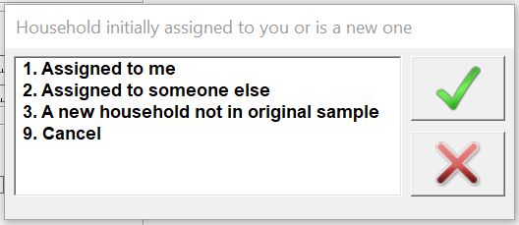
Interviewer’s Menu

Slide 19
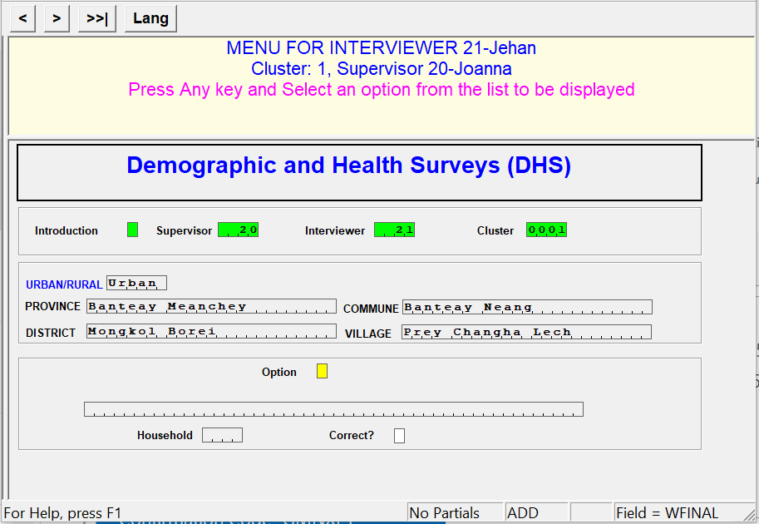

Slide 20
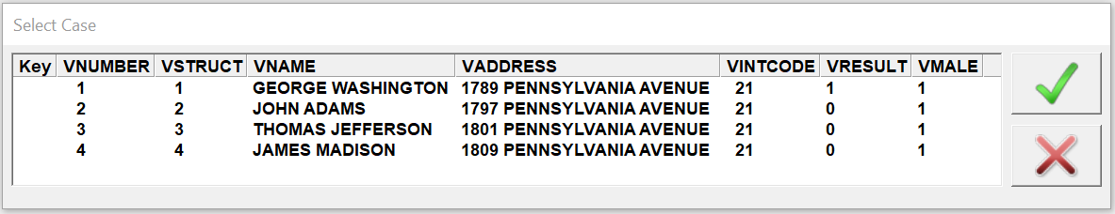

Slide 21
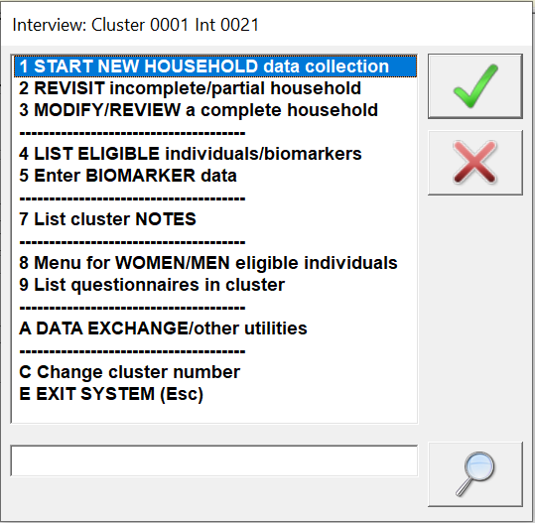
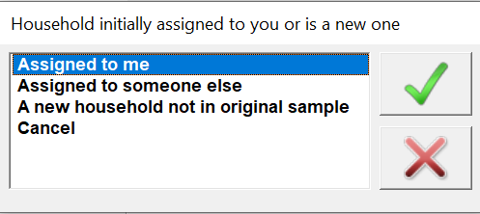

Slide 22
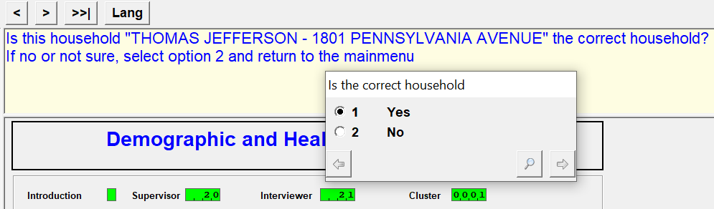

Slide 23
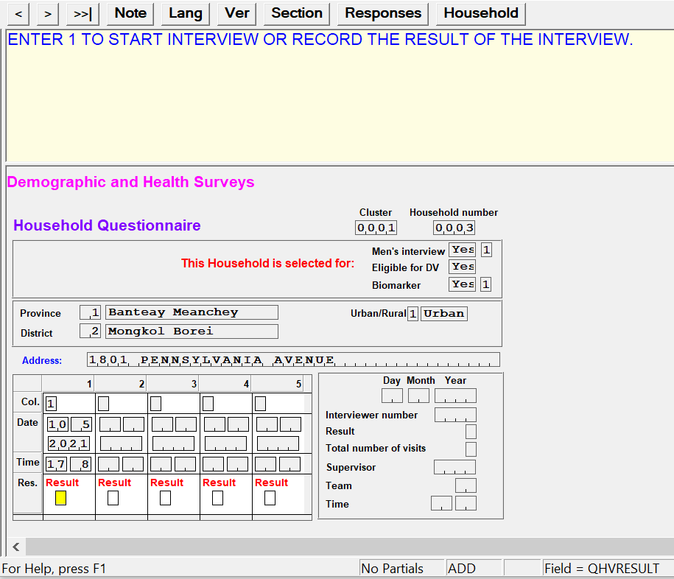
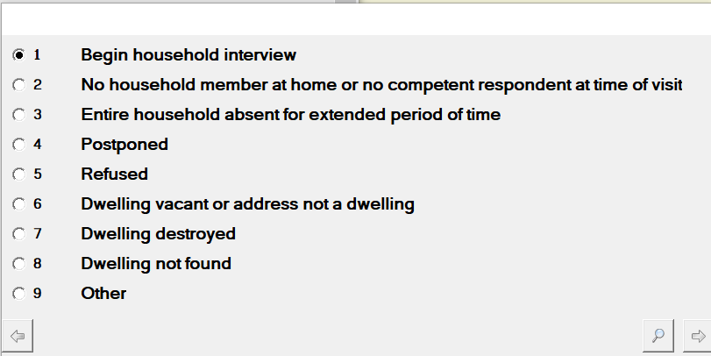

Slide 24
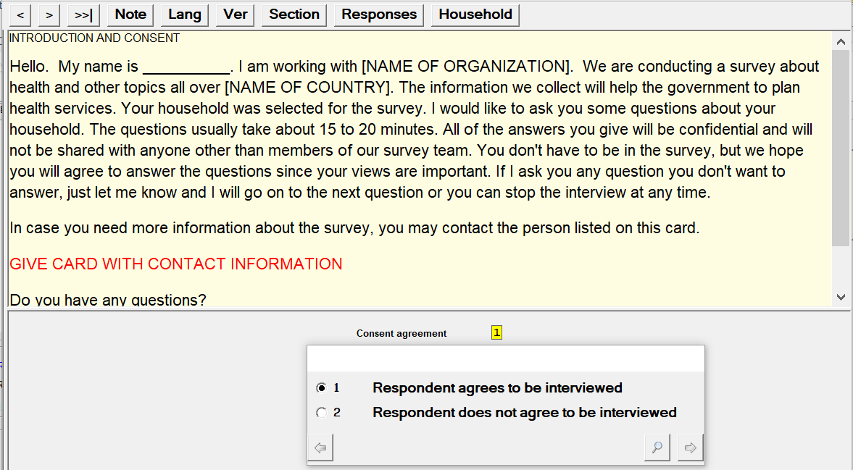
Scroll
down

Slide 25
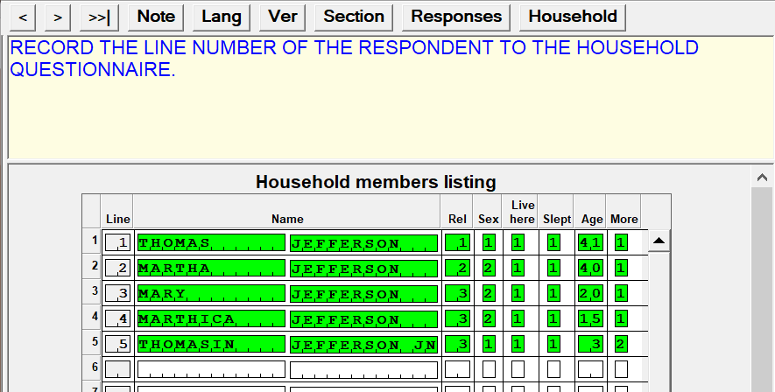
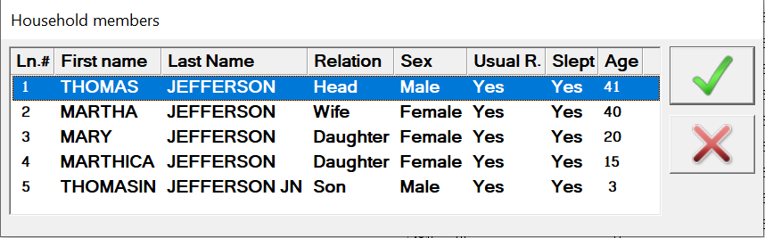

Slide 26
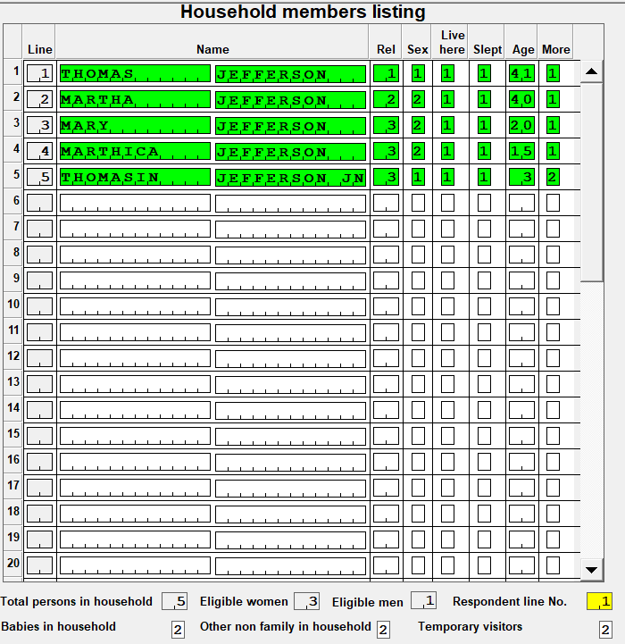

Slide 27
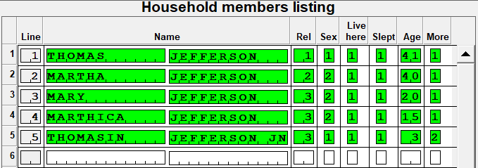
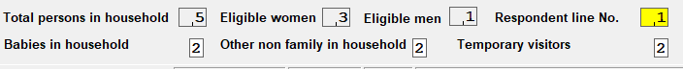


Slide 28



Return to last field

Slide 29


Language
GPS
Time
Domestic violence

Slide 30

Language
GPS
Time
Domestic violence

Slide 31



Language
GPS
Time
Domestic violence

Slide 32



This button will clear off the note area
Click OK button when done

Slide 33



Slide 34



Slide 35


Slide 36


Slide 37


Slide 38


Slide 39


Slide 40



Slide 41

2 + 2 + 2 = 6
2 terminations

Slide 42



2 + 2 + 2 = 6
2 terminations

Slide 43


Stage 1. Pregnancies Summary
Stage 2. Listing all Pregnancies
Stage 3. Live Births

Slide 44




Pregnancies order
(First-to-last)
Q212
Girls =Q203a+Q205a+Q207a
Boys= Q203b+Q205b+Q207b

Slide 45



Slide 46



Slide 47




Slide 48

2
3
A line will be inserted
1
Cursor position

Slide 49


Slide 50


Slide 51


Slide 52




Slide 53





Slide 54






Slide 56




Slide 57




Slide 58

Duration
Miscarriage
Twin:
William & James
Twin:
Liam & Charlote

Slide 59





Currently pregnant
03 months duration
Type of method
Date last episode -
4 months duration

Slide 60


Q304
Calendar (Q317c)

Slide 61



Slide 62


Slide 63







Gap - 1
Gap - 2
Gap - 3
Gap - 4

Slide 64


Slide 65




Slide 66



Slide 67


Slide 68






Slide 69

Name and line#
Date-of-birth
Vaccine given but not date
Not given

Slide 70


Slide 71




Exit
Picture area
Before taking the picture make sure the resolution is legible
Take picture

Slide 72

Exit
Picture area
Before taking the picture make sure the resolution is legible
Take picture

Slide 73




Slide 74




Only vaccines with “0” will be listed
Replaced with “66”

Slide 75




Slide 76



Slide 77


Slide 78


Receiving (Server)
Sending (Client)

Slide 79


Receiving (Server)
Sending (Client)
Before sending data, select the desire interviewer(s)

Slide 80


Slide 81


Slide 82


Slide 83



Slide 84


Slide 85



Slide 86




Slide 87




Slide 88


Slide 89

Paper questionnaire
0
3

Slide 90




Number
Unit

Slide 91






CAPI
Paper questionnaire
0
1
1
9
8
0
Filter

Slide 92
Filter

Slide 93






Slide 94




Slide 95



Slide 96





Slide 98


Slide 99

Message #
Data collected
Message type
Message text
Go-To buttons

